Slide 1


JAVA Java Interview boot camp Core concepts
Lecture 20
CHAPTER 21
Nested/Inner Classes-Part 2

Slide 2
Example
public class Computer {
//required parameters
private String HDD;
private String RAM;
//optional parameters
private boolean isGraphicsCardEnabled;
private boolean isBluetoothEnabled;
}
Challenge:
Write code to initialize object of Computer class in a single line of code

Slide 3
Solution 1
The simplest way that comes to our mind for instantiating and initializing a Computer object is to create a Constructor.
The Constructor will accept 4 arguments and will use them to initialize the object.

Slide 4
Solution 1
public class Computer {
//required parameters
private String HDD;
private String RAM;
//optional parameters
private boolean isGraphicsCardEnabled;
private boolean isBluetoothEnabled;
//a public constructor
public Computer(String HDD,String RAM,Boolean isGraphicsCardEnabled,Boolean isBluetoothEnabled) {
this.HDD=HDD;
this.RAM=RAM;
this.isGraphicsCardEnabled=isGraphicsCardEnabled;
this.isBluetoothEnabled=isBluetoothEnabled;
}
….
}

Slide 5
Problems
Although the code will work fine but there are 3 issues:
What if we do not want to pass any value to optional parameters ?
What will happen if the class contains many members ?
How will a new developer who tries to instantiate thos class remember the order of arguments ?
To understand these problems , imagine we want to instantiate a SmartHome class as shown in next slide

Slide 6
Problems
public class SmartHome {
private String name;
private int serialNumber;
private String addressName;
private String addressNumber;
private String city;
private String country;
private String postalCode;
private int light1PortNum;
private int light2PortNum;
private int door1PortNum;
private int door2PortNum;
private int microwavePortNum;
private int tvPortNum;
private int waterHeaterPortNum;
public SmartHome(String name, int serialNumber, String addressName, String addressNumber, String city, String country, String postalCode, int light1PortNum, int light2PortNum, int door1PortNum, int door2PortNum, int microwavePortNum, int tvPortNum, int waterHeaterPortNum) {
// Assigning values in the constructor call
}
// Getters and Setters
}

Slide 7
Problems
We face too many arguments in the constructor, and with low type-variety, we'll be looking at a huge constructor call with no way of knowing what's what.
The code has become unreadable and incomprehensible

Slide 8
A Better Solution
This is where the Builder Pattern jumps in:
The Builder Pattern separates the construction from the representation.
What does this mean?

Slide 9
A Better Solution
The construction is done in the class itself.
The representation is what we see as the user of the class.
Right now, our classes have these two tied together - we directly call the constructor with the passed arguments.
By separating these two, we can make the representation of the class a lot simpler, neater and readable, while the constructor does its part.

Slide 10
How To Implement Builder Design Pattern ?
There are few steps to take in order to implement the Builder Pattern.
Continuing with our first example, we'll use the Computer class to show these steps:
A static builder class should be nested in our Computer class
The Computer constructor should be private so the end-user can't call it
The builder class should have an intuitive name, like ComputerBuilder
The ComputerBuilder class will have the same fields as the Computer class

Slide 11
How To Implement Builder Design Pattern ?
The fields in the Computer class can be final or not, depending if we want it to be immutable or not
The ComputerBuilder class will contain methods that set the values, similar to setter methods.
These methods will feature the ComputerBuilder as the return type, assign the passed values to the fields of the static builder class
The static builder class will contain a build() method that injects these values into Computer and returns an instance of it.

Slide 12
Solution 2
public class Computer {
//required parameters
private String HDD;
private String RAM;
//optional parameters
private boolean isGraphicsCardEnabled;
private boolean isBluetoothEnabled;
public String getHDD() {
return HDD;
}
public String getRAM() {
return RAM;
}

Slide 13
Solution 2
public boolean isGraphicsCardEnabled() {
return isGraphicsCardEnabled;
}
public boolean isBluetoothEnabled() {
return isBluetoothEnabled;
}
private Computer(ComputerBuilder builder) {
this.HDD=builder.HDD;
this.RAM=builder.RAM;
this.isGraphicsCardEnabled=builder.isGraphicsCardEnabled;
this.isBluetoothEnabled=builder.isBluetoothEnabled;
}

Slide 14
Solution 2
//Builder Class
public static class ComputerBuilder{
// required parameters
private String HDD;
private String RAM;
// optional parameters
private boolean isGraphicsCardEnabled;
private boolean isBluetoothEnabled;
public ComputerBuilder(String hdd, String ram){
this.HDD=hdd;
this.RAM=ram;
}

Slide 15
Solution 2
public ComputerBuilder setGraphicsCardEnabled(boolean isGraphicsCardEnabled) {
this.isGraphicsCardEnabled = isGraphicsCardEnabled;
return this;
}
public ComputerBuilder setBluetoothEnabled(boolean isBluetoothEnabled) {
this.isBluetoothEnabled = isBluetoothEnabled;
return this;
}
public Computer build(){
return new Computer(this);
}
}
}

Slide 16
Solution 2
public class TestBuilderPattern {
public static void main(String[] args) {
Computer comp = new Computer
.ComputerBuilder("500 GB", "2 GB")
.setBluetoothEnabled(true)
.setGraphicsCardEnabled(true)
.build();
}
}

Slide 17
Inner Class
We can define a class (or an interface) as a non-static member inside another class.
How about declaring a class or an interface inside an interface?
As we saw in earlier slide when we define a class or an interface inside an interface, it is implicitly static.
So, it is not possible to declare a non-static inner interface!

Slide 18
Inner Class
That leaves two possibilities:
class Outer { // an outer class has an inner class class Inner { } } class Outer { // an outer class has an inner interface interface Inner { } }

Slide 19
Exercise
Create a Point class to implement the center of a Circle.
Since we want to associate each Circle with a centerPoint, make Point an inner class of Circle.

Slide 20
Exercise
The class Point should have 2 int variables to represent x and y axis value of the point.
Also it should have a parametrized constructor to initialize the Point object and an overridden toString() method.

Slide 21
Exercise
The class Circle should have an integer radius and a Point object as it’s data member.
Also it should have a triple argument parametrized constructor to initialize all the data members and an overridden toString() method.

Slide 22
Example
public class Circle { // define Point as an inner class within Circle class class Point { private int xPos; private int yPos; // constructor for an inner class public Point(int x, int y) { xPos = x; yPos = y; } // overridden method public String toString() { return "(" + xPos + "," + yPos + ")"; } }

Slide 23
Example
// make use of the inner class for declaring a field private Point center; private int radius; public Circle(int x, int y, int r) { // use of the inner class to instantiate it center = this.new Point(x, y); radius = r; } public String toString() { return "mid point = " + center + " and radius = " + radius; } public static void main(String []s) { System.out.println(new Circle(10, 10, 20)); } // other methods such as area }
Output:
Mid point=(10,10) and radius=20

Slide 24
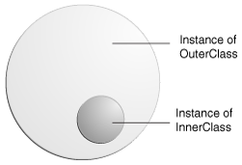
Points To Remember About Inner Class
Every inner class is associated with an instance of the outer class. In other words, an inner class is always associated with an enclosing object.

Slide 25
Points To Remember About Inner Class
It means that without a reference to an instance of the outer class, we can’t instantiate the inner class from a static method of the outer class (because, don’t forget, in static code, there is no this reference), or from any other code in any other class.
Inner class instances are always handed an implicit reference to the outer class.

Slide 26
Points To Remember About Inner Class
The outer and inner classes share a special relationship, like friends or members of same family. Member accesses are valid irrespective of the access specifiers such as private.
However, there is subtle difference.
We can access members of an outer class within an inner class without creating an instance; but this is not the case with an outer class.
We need to create an instance of inner class in order to access the members (any members, including private members) of the inner class.

Slide 27
Points To Remember About Inner Class
One limitation of inner classes is that we cannot declare static members in an inner class, like this:
class Outer { class Inner { static int i = 10; } }
If we try to do so, we’ll get the following compiler error:
Outer.java:3: inner classes cannot have static declarations static int i = 10;

Slide 28
Points To Remember About Inner Class
Just like top-level classes, an inner class can extend a class or can implement interfaces.
Similarly, an inner class can be extended by other classes, and an inner interface can be implemented or extended by other classes or interfaces.
An inner class can be declared final or abstract

Slide 29
Points To Remember About Inner Class
If we want to create an instance of the inner class, we must have an instance of the outer class.
The syntax is:
<OuterClass.InnerClass> <objref>=<outerobjref>.new <InnerClass()>
For example:
Outer out=new Outer();
Outer.Inner in=out.new Inner();

Slide 30
Points To Remember About Inner Class
Can you make a one liner for the previous code ?
Yes:
Outer.Inner in=new Outer().new Inner();

Slide 31
Points To Remember About SNC
When we define an inner nested class (or interface) inside an interface, the nested class is declared implicitly public and static.
This point is easy to remember: any field in an interface is implicitly declared public and static, and static nested classes have this same behavior.

Slide 32
Referencing Inner/Outer Instance From Inner Class
Within an inner class code, the this reference refers to the instance of the inner class, since this always refers to the currently executing object.
But what if the inner class code wants an explicit reference to the outer class instance that the inner instance is tied to?
In other words, how do we reference the “outer this”?

Slide 33
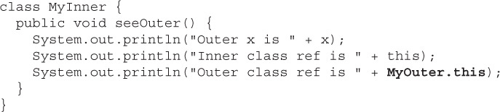
Referencing Inner/Outer Instance From Inner Class
This is done using <outerclassname>.this.
MyOuter is the name of the Outer class

Slide 34
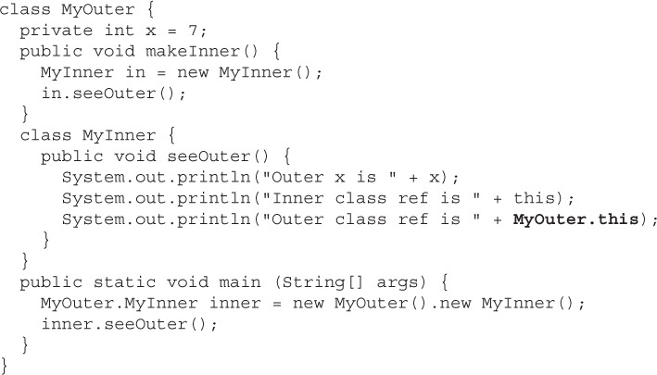

Referencing Inner/Outer Instance From Inner Class
Output:

Slide 35
Conclusions About “this”
To reference the inner class instance itself from within the inner class code, use this.
To reference the “outer this” (the outer class instance) from within the inner class code, use NameOfOuterClass.this(example, MyOuter.this).

Slide 36
Modifiers Applied To Inner Class
A regular inner class is a member of the outer class just as instance variables and methods are, so the following modifiers can be applied to an inner class:
final
abstract
public
private
protected
static—but static turns it into a static nested class, not an inner class
strictfp

Slide 37
Local Inner Class
A local inner class is defined in a code block (for example in a method body).
Unlike static nested classes and inner classes, local inner classes are not members of an outer class; they are just local to the method or code in which they are defined.
Syntax:
class SomeClass { void someFunction() { class Local { } } }

Slide 38
Instantiating Local Inner Class
When we declare the inner class it doesn’t mean we created an instance of it.
So to use the inner class, we must make an instance of it somewhere within the method but below the inner class definition(or the compiler won’t be able to find the inner class)

Slide 39
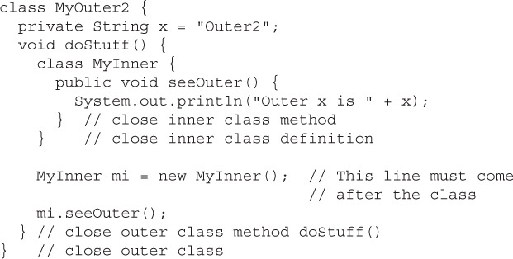
Instantiating Local Inner Class
Must appear only after closing brace of inner class

Slide 40
Where Can We Instantiate Local Inner Class ?
A method-local inner class can be instantiated only within the method where the inner class is defined.
In other words, no other code running in any other method—inside or outside the outer class—can ever instantiate the method-local inner class.

Slide 41
What Inner Class Instance Cannot Do ?
The inner class object cannot use the local variables of the method the inner class is in.

Slide 42
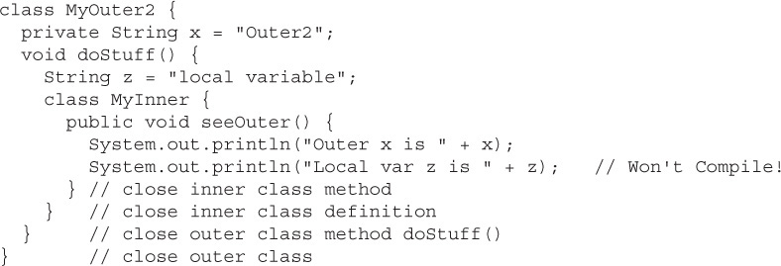
What Inner Class Instance Cannot Do ?
This is OK!
This is not allowed!

Slide 43
Why Is It So ?
The local variables of the method live on the stack and exist only for the lifetime of the method.
When the method ends, the stack frame is blown away and the variable is removed.
But even after the method completes, the inner class object created within it might still be alive on the heap

Slide 44
Why Is It So ?
For example, a reference to inner class object was passed into some other code.
Because the local variables aren’t guaranteed to be alive as long as the method-local inner class object is, the inner class object can’t use them.

Slide 45
Solution
Declare the variable as final
Marking the local variable z as final fixes the problem:
final String z = "local var"; // Now inner object // can use it

